Slide 1



The Trauma of Bullying
Dr Nathalie Noret,
Department of Education
University of York
World Anti-Bullying Forum, 2025

Slide 2
Overview
Background
Findings from the evaluation of the therapeutic intervention
Conclusions
Time for questions
Findings related to the traumatic impact of bullying

Slide 3
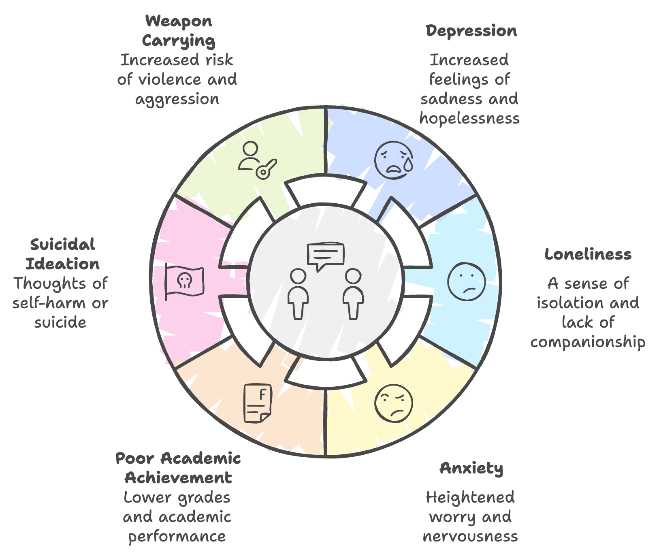
Background
Bullying is a frequent experience for many young people in school.
  In the Anti-Bullying Alliance’s recent survey (ABA, 2002)
  The Good Childhood Report (2024) identified that the UK had the second highest prevalence rate of bullying in Europe (Based on HBSC, 2023).
Being bullied is associated with:
  a range of poor mental health outcomes.
  attendance and engagement in school.
Evaluations of anti-bullying interventions suggest they only lead to small-moderate changes in bullying behaviour (Hensums et al., 2023)
Figure 1:
Mental health outcomes associated with being bullied.

Slide 4
Background
Is bullying traumatic?
  There have been recent calls for bullying to be defined as a traumatic experience (Idsoe et al., 2021; Jenkins et al., 2023).
The relationship between being bullied and symptoms of trauma.
  evidence also suggests a relationship between being bullied and symptoms of trauma (e.g., Crosby et al., 2010), which is consistent across
    different forms of bullying (e.g., Litman et al. 2015).
    different roles in bullying (e.g., Mateu et al., 2020).
    when other forms of traumatic childhood experiences have been controlled for (e.g., McGuckin et al., 2011).
The implications of considering bullying as a trauma.
  For how we understand the relationship between being bullied and negative outcomes.
  For intervention.

Slide 5
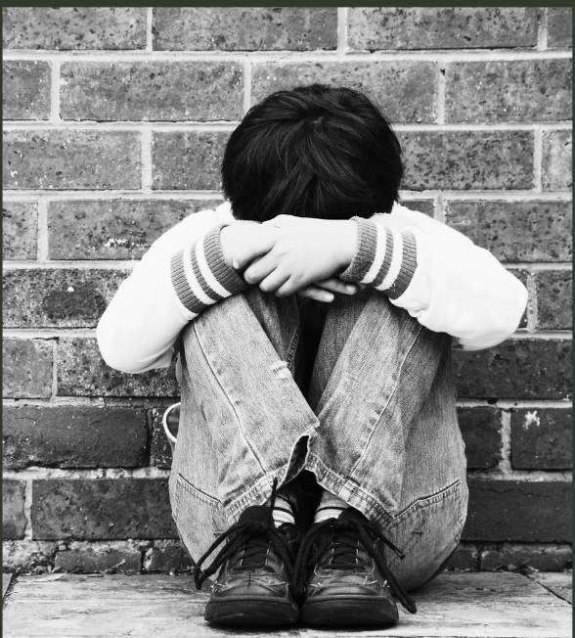
Research Aims
Kidscape Commissioned us to evaluate the use of a therapeutic intervention (delivered by Service Six) to reduce the impact of bullying on children and young people’s mental health.
The aim of the study was to
  examine the traumatic impact of being chronically bullied in school and
  evaluate a small-scale pilot of a trauma-informed therapeutic approach to support children and young people being chronically bullied in school.

Slide 6
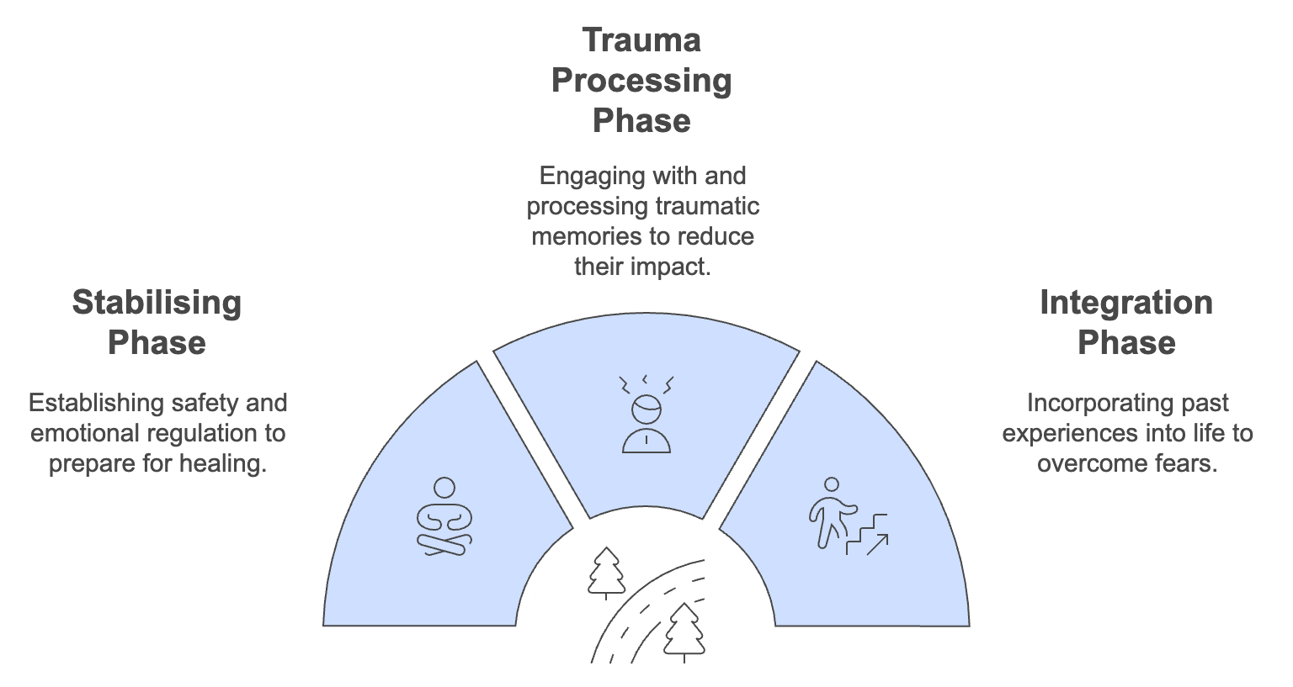
The Trauma Informed Therapeutic Approach
Stage one is the safety and stabilisation phase, which incorporates
Emotional and physical regulation.
Emotional literacy (why I feel these emotions).
Processing negative self-beliefs (I am not worthwhile).
Psychoeducation, learning why the brain reacts to trauma.
Safety strategies and self-care.
Stage two is the trauma processing phase. Different therapies are offered
Talking through their experience until the impact is less impactful.
Creatively drawing or processing their experience.
Nonverbal techniques for those who are too distressed to talk about the incidents.
Through play.
Stage three is the reconnection phase
Reconciliation with self.
Reconnection with others.
Resolving the trauma.
https://www.servicesix.co.uk/

Slide 7
The Trauma Informed Therapeutic Approach
Participating children were offered up to twelve fully funded therapeutic support sessions through BACP-accredited provider Service Six.
  For young people under the age of 13, the clinical assessment is completed with the therapist and the parent. For young people over the age of 13, the clinical assessment is completed with the young person, parent and therapist.
  Where possible, sessions were offered face to face in the Service Six offices.
  When this was not possible, ‘zoom workplace’ was used, to provide sessions.
Each therapist was provided with clinical supervision who was CYP qualified, and trauma informed which is a formal process to support our therapists providing support, reflection and guidance.
https://www.servicesix.co.uk/

Slide 8

Method
STEP 01
STEP 02
STEP 03
The participants in the study included parents/carers of young people who were experiencing bullying in school and had contacted the Kidscape Parent Advice line.
In total, 20 families were offered therapeutic support, and 18 agreed to participate in this evaluation of the support.
The young people ranged between 8 and 16 years old (M=11.28, SD=2.24), 9 (50%) young people were male, and 9 (50%) were female.
The questionnaires included:
Parent/carers' reports of their child's experiences of bullying (OBVQ, Demaray et al., 2013; Solberg & Olweus, 2003);
Parent reports of their trauma symptoms (Child & Adolescent Trauma Scale, Parent Report, Sachser et al., 2017)
In questionnaires 2 and 3, their opinions of the impact of the therapeutic intervention.
Parents were asked to complete three questionnaires before, immediately after, and three months after the intervention.
For the evaluation we had data from 18 parents at time 1 and 8 parents at the end of the study.

Slide 9
Results
The majority of parents reported that their child had been bullied several times a week.
15 (83.3%) participants reported that their child had taken time out of school because of bullying.
All the parents in the study (N=18) had reported their child's experiences of bullying to the school.
  Four parents (22.2%) reported that the bullying had improved since reporting.

Slide 10

Results
Parent 1: “Teachers said for a long time that Sam was sensitive to the other boy and that it was not targeted bullying. He was not validated or acknowledged at school until we fought them until they did. 3 weeks ago, Sam was moved into another class as the bully cannot be moved for unknown reasons.”
Parent 2: “I repeatedly reported the incidents, but school said they couldn't find any evidence. They ostracised my son, spread rumours about him and surrounded him. They were verbally nasty and made threats of violence. After the evidence was found and they were punished, they have continued to target him on a lower scale - tripping him up with a hockey stick; pushing him over repeatedly; telling him they have never bullied him and he is a liar. School have said the latest incidents were "accidents". I don't think they are willing to admit that the bullying is ongoing.”

Slide 11
Results: The impact of being bullied
TRAUMA SCORES
When interpreting the CATS, a total trauma score of 21 can be used to indicate clinically relevant trauma symptoms.
At the start of the study, all 18 participants had a trauma score of over 21.
OTHER IMPACTS
Bullying was found to impact on children/ young people in terms of feelings of:
Poor mental health
Physical Symptoms
Fear and Trust
Impact on learning/ engagement in school
Confidence
Social Isolation
"Alice took an intentional overdose of 16 paracetamol."
"Having tummy pain, nausea, headache, panic attacks, challenging behaviour".
"She struggles to get to sleep and does not sleep well and this seems worse when she is having a poor time at school."
"He sits in class fearing the bully will burst in and attack him."
"It has been devastating to my child's wellbeing, confidence and academic progress."
"He didn't feel safe at school no one believed him".
"My son, avoids social gathering outside people he knows. He relies on, online friends."

Slide 12
Results: The impact of bullying on parents
Bullying was found to impact parents in terms of:
feelings of worry and stress related to bullying,
the emotional impact,
the impact on the whole family,
the development of conflict in the family because of bullying, and
the impact on parents' work.
"It is heartbreaking when he [their child] says he wishes he was normal like everyone else. When he gets angry, it isn't easy to help him. Causes stress and strain."
"I felt I was in some ways responsible for what was happening to my son. As his father, I believed I was failing him even though I followed the school's protocol."
"I have taken unpaid leave from work to look after her, which is causing financial difficulty and extreme stress about what happens to her when I inevitably have to return to work."
"The bullying has impacted on every inch of our family life, and it is something we will never forget."
"Sophie's brother thinks we don't care about him, he is getting jealous, upset, angry, can't understand what is going on with his sister."

Slide 13

Results: Changes in trauma scores
TABLE 1: Descriptive Statistics for the trauma scores, before and after the intervention
 | Start (N=18) | End (N=8) | Wilcoxon
Total Trauma Score | 43.72 (10.55) | 31.71 (19.29) | -1.97*
Reexperiencing | 10.94 (3.56) | 7.75 (4.26) | -2.23*
Avoidance | 4.61 (1.58) | 4.13 (1.73) | -0.65
Negative Mood | 16.06 (2.88) | 11.00 (7.71) | -1.83
Hyperarousal | 12.11 (3.72) | 8.50 (6.65) | -1.97*
*p <.05
CLINICALLY RELEVANT TRAUMA SCORES
In the final survey, of the eight participants who participated in the survey, 5 (62.5%) had a clinically relevant score, and the scores for 3 (37.5%) participants had reduced to be not clinically relevant.

Slide 14
Results: Parent perceptions
"At the time this help was offered it was THE ONLY HELP that we could get from anyone, including the school, NHS, private therapists or even social services. We were told that because we were a loving supportive family we were not a priority and that we were trusted to give Alice the support that she needed. But we didn't feel confident, skilled or knowledge enough to give that support. We weren't who she wanted, she needed someone independent and we needed to feel like SOMETHING practical was being done to help her get through this safely."

Slide 15
Discussion
The results of the study highlight the profound impact that chronic bullying can have on children, young people and their families:
  Consistent with previous research, being bullied was associated with symptoms of trauma and all children and young people had a clinically relevant trauma score.
  Other outcomes also included symptoms of poor mental health (i.e., depression, anxiety, anger), suicidal thoughts and self-harm, problems sleeping and eating, social isolation, a lack of confidence, loss of trust, and greater feelings of fear.
  Findings also highlight the impact school response may have on young people being bullied.
  Findings from the evaluation of the therapeutic intervention suggest that the therapeutic intervention significantly reduced symptoms of trauma, particularly symptoms of re-experiencing and hypervigilance.

Slide 16
Discussion
A small-scale evaluation.
  But the first study of its kind to examine a bullying specific trauma-informed therapeutic approach to support children and young people who were being chronically bullied in school.
  Small sample, limited to parent reports.
We used well developed scales of trauma.
  But due to time constraints and ethical concerns our study was based on parent reports.
  Any future work would benefit from taking a multi-informant approach.
Possible potential for trauma informed approaches
  For those chronically bullied
  Applicability of school-based trauma informed interventions

Slide 17


Thank you.
To Kidscape, Service Six, and all the parents and their children who participated in this project.
To my collaborators, Husna Hejazi, Katelynn Wilson, Paula Timms, Kat Fuller and Yvette Lambe.

Slide 18
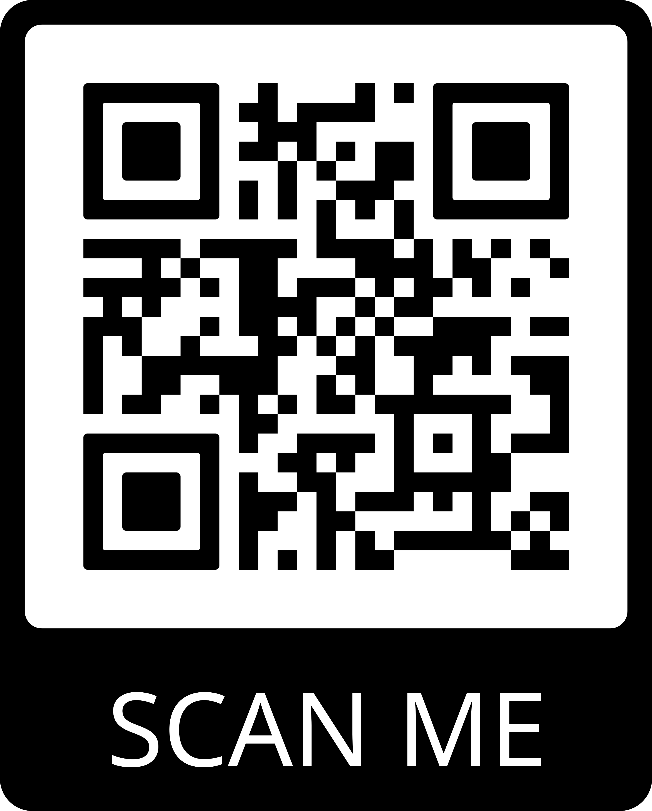
Thank you for listening.
Any Questions?
Email: nathalie.noret@york.ac.uk
Bluesky: @natnoret.bsky.social
Webpages:
https://bullyingthoughtsfeelings.com/
https://www.kidscape.org.uk/bullying-and-trauma/

Slide 19
References
Anti-Bullying Alliance. (n.d.). Bullying, School Experiences and Wellbeing: a Picture of Pupil Experience in England 2022. Retrieved April 15, 2024, from https://anti-bullyingalliance.org.uk/tools-information/all-about-bullying/prevalence-and-impact-bullying/prevalence-bullying
Corby, E. K., Campbell, M., Spears, B., Slee, P., Butler, D., & Kift, S. (2016). Students’ Perceptions of Their Own Victimization: A Youth Voice Perspective. Journal of School Violence, 15(3), 322–342. https://doi.org/10.1080/15388220.2014.996719
Crosby, J. W., Oehler, J., & Capaccioli, K. (2010). The relationship between peer victimization and post-traumatic stress symptomatology in a rural sample. Psychology in the Schools, 47(3), 297–310. https://doi.org/10.1002/pits.20471
Demaray, M. K., Malecki, C. K., Secord, S. M., & Lyell, K. M. (2013). Agreement among students’, teachers’, and parents’ perceptions of victimization by bullying. Children and Youth Services Review, 35(12), 2091–2100. https://doi.org/10.1016/j.childyouth.2013.10.018
Hensums, M., de Mooij, B., Kuijper, S. C., Cross, D., DeSmet, A., Garandeau, C. F., Joronen, K., Leadbeater, B., Menesini, E., Palladino, B. E., Salmivalli, C., Solomontos-Kountouri, O., Veenstra, R., Fekkes, M., & Overbeek, G. (2023). What Works for Whom in School-Based Anti-bullying Interventions? An Individual Participant Data Meta-analysis. Prevention Science, 24(8), 1435–1446. https://doi.org/10.1007/s11121-022-01387-z
Idsoe, T., Vaillancourt, T., Dyregrov, A., Hagen, K. A., Ogden, T., & Nærde, A. (2021). Bullying Victimization and Trauma. Frontiers in Psychiatry, 11. https://doi.org/10.3389/fpsyt.2020.480353
Jenkins, L. N., Miller, H. H., Kaminski, S., & Putzeys, S. (2023). Re-conceptualizing Peer Victimization as a Potentially Traumatic Event. International Journal of Bullying Prevention, 5(2), 151–160. https://doi.org/10.1007/s42380-022-00129-7
Litman, L., Costantino, G., Waxman, R., Sanabria‐Velez, C., Rodriguez‐Guzman, V. M., Lampon‐Velez, A., ... & Cruz, T. (2015). Relationship between peer victimization and posttraumatic stress among primary school children. Journal of Traumatic Stress, 28(4), 348-354.
Mateu, A., Pascual-Sánchez, A., Martinez-Herves, M., Hickey, N., Nicholls, D., & Kramer, T. (2020). Cyberbullying and post-traumatic stress symptoms in UK adolescents. Archives of Disease in Childhood, 105(10), 951–956. https://doi.org/10.1136/archdischild-2019-318716
Mc Guckin, C., Lewis, C. A., Cummins, P. K., & Cruise, S. M. (2011). The stress and trauma of school victimization in Ireland: A retrospective account. Psychology, Society and Education, 3(1), 55-67.
Olweus, D. (1999). Sweden. In P. K. Smith, M. J. Junger-Tas, D. A. Olweus, Richard. F. Catalano, & Philip. T. Slee (Eds.), The nature of school bullying: A cross-national perspective (pp. 7–27). Routledge.
Overstreet, S., & Chafouleas, S. M. (2016a). Trauma-Informed Schools: Introduction to the Special Issue. School Mental Health 8(1), 1–6. https://doi.org/10.1007/s12310-016-9184-1
Sachser, C., Berliner, L., Holt, T., Jensen, T. K., Jungbluth, N., Risch, E., Rosner, R., & Goldbeck, L. (2017). International development and psychometric properties of the Child and Adolescent Trauma Screen (CATS). Journal of Affective Disorders, 210, 189–195. https://doi.org/10.1016/j.jad.2016.12.040
Solberg, M. E., & Olweus, D. (2003). Prevalence Estimation of School Bullying with the Olweus Bully/Victim Questionnaire. Aggressive Behavior, 29(3), 239–268. https://doi.org/10.1002/ab.10047
van der Kolk, B. A., McFarlane, A. C., & Weisaeth, L. (1996). Traumatic Stress: The Effects of Overwhelming Experience on Mind, Body, and Society. Guildford Press.
Whitney, I., & Smith, P. K. (1993). A survey of the nature and extent of bullying in junior/middle and secondary schools. Educational Research, 35(1), 3–25. https://doi.org/10.1080/0013188930350101

